Slide 1
Case study: How does a bike-share navigate speedy success?
By Swapna Macha
Updated on 2024

Slide 2
Contents
Introduction
The Data
Analysis
Summary of Riders
Rider Preferences Based on Bike Types
Average Ride Duration of Each Rider Type
Rider Counts Based on Ride Start Time
Rides During Weekdays
Rides Across Months
Rides During Seasons
How Are Members and Casual Riders Using Cyclistic?
Recommendations

Slide 3
Introduction
Cyclistic, a bike-share company in Chicago, launched bike-share program that features more than 5,800 bicycles and 600 docking station
Customers, who purchase single ride, or full-day passes are referred to as casual riders and who purchase annual memberships are Cyclistic members.
Cyclistic finance analysts have concluded that annual members are much more profitable than casual riders.
Moreno, the director of marketing has set a clear goal to design marketing strategies aimed at converting casual riders into annual members.
Answering the question, “How do annual members and casual riders use Cyclistic bikes differently?” will guide the future marketing program.
This presentation provides, a summary of analysis to answer the above question and necessary recommendations to guide the future marketing program.

Slide 4
For the purposes of this case study, The 12 months of Cyclistic’s historical trip, public data available by Motivate International Inc. under license is used
The Data

Slide 5
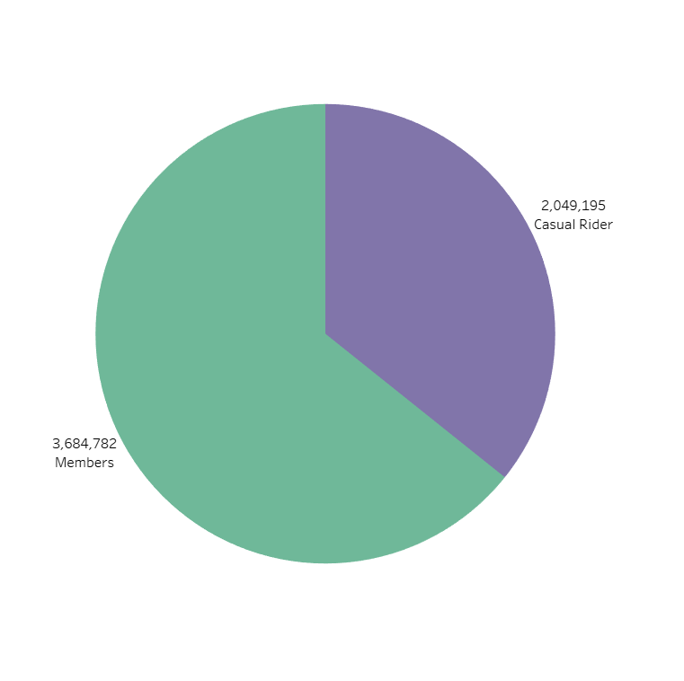

Summary of Riders
Members are more in number than Casual Riders

Slide 6
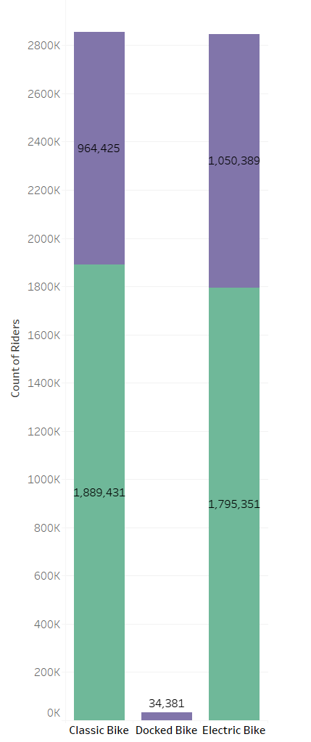
Rider Preferences Based on Bike Types
Both Members and Casual Riders prefer classic and electric bikes over docked bikes.

Slide 7
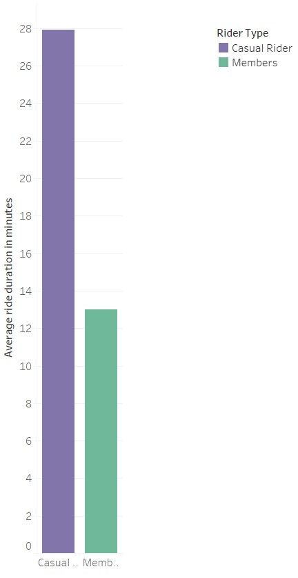
Average Ride Duration of Each Rider Type
Casual Riders do long rides compared to Members

Slide 8
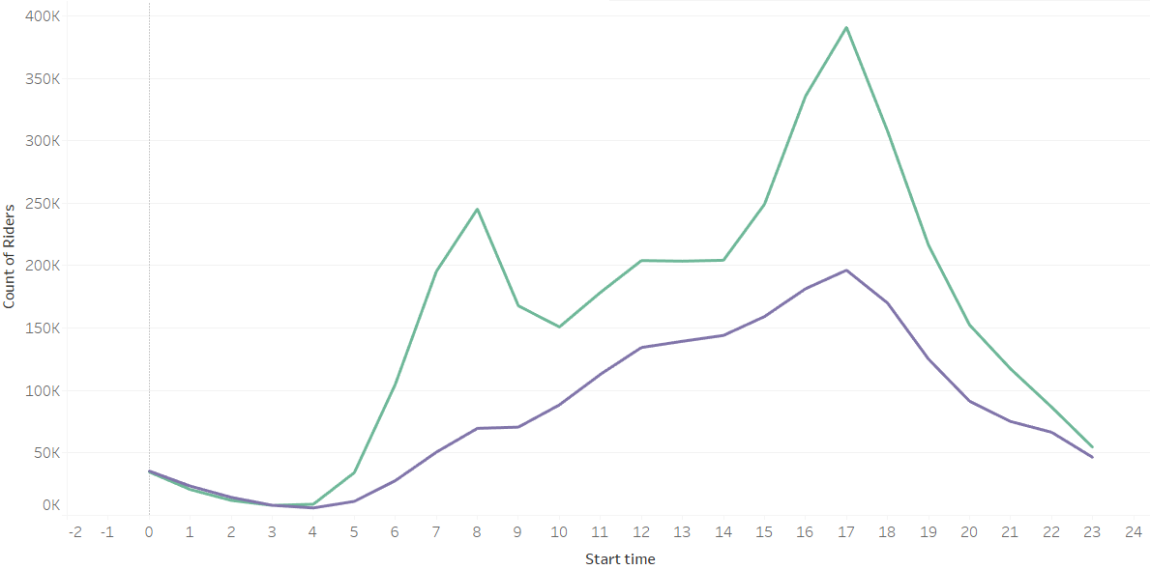

Rider Counts Based on Ride Start Time
The peak and non-peak hours are similar for both Members and Casual Riders

Slide 9
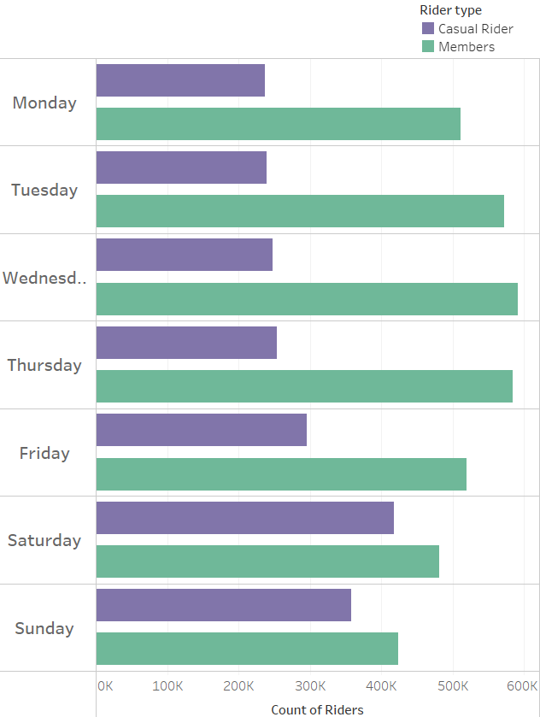
Rides During Weekdays
Casual Riders prefer to ride during weekends whereas Members prefer riding on week days.

Slide 10

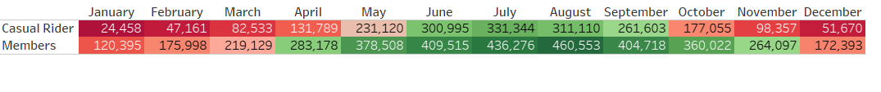
Rides Across Months
Both Members and Casual riders prefer to ride during June, July, august and September months

Slide 11
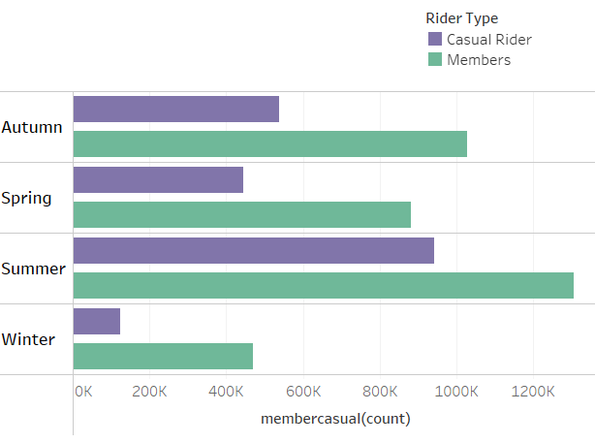
Rides During Seasons
Both Members and Casual riders do less rides in winter and more rides in summer

Slide 12
How Are Members and Casual Riders Using Cyclistic bikes?
Members
Casual Riders
More in number
Doesn’t ride docked bikes
Rides are shorter
Prefer riding on week days.
Both prefer classic and electric bikes over docked bikes
Peak and non-peak hours are similar for both
Both prefer to ride during June, July, august and September months
Both do less rides in winter and more rides in summer
Less in number
Rides docked bikes
Rides are longer
Prefer to ride during weekends

Slide 13
Recommendations
Introduce a membership which enables riders to have 2 hrs rides during weekends.
Introduce a membership which enables riders to have 2 hrs rides during any 8 days in a month (This provides flexibility for riders who prefer to do longer rides either weekends or weekdays)
Introduce a membership which enables riders to have a total of 10 hrs rides in a month (This provides flexibility for riders who prefer to ride more shorter rides or few longer rides)
Increase the fleet of electric bikes and classic bikes

Slide 14
Thank You.

